Slide 1

DEPARTMENT OF COMPUTER SCIENCE AND ENGINEERING
Professional Training I
PERSONAL STUDY TIMETABLE GENERATOR
PROJECT STUDENT GUIDE
CH.TEJA - 44111191 DR.G.NAGARAJAN
ASSOCIATE PROFESSOR

Slide 2
AGENDA
Certificate
Abstract
Introduction
Objective
System Architecture / Ideation Map
Module Implementation
Results and Discussions
Conclusion
References

Slide 3
COURSE CERTIFICATE

Slide 4
ABSTRACT
The Personal Study Timetable Generator is a web-based application designed to help students organize their study schedules efficiently. It allows users to add multiple subjects, set their own study timings, and generate personalized timetables based on their availability. The system includes features such as subject management, a study timer, progress tracking, and timetable editing. It uses HTML, CSS, and JavaScript to provide a simple and user-friendly interface. Local Storage is used to save subjects, schedules, and progress even after the browser is closed. This application helps students improve time management, maintain consistent study habits, and achieve their academic goals.

Slide 5
INTRODUCTION
The Personal Study Timetable Generator is a web-based application designed to help students manage their study schedules effectively. It allows users to add multiple subjects, set their own study timings, and create personalized timetables based on their availability. The application includes features such as subject management, timetable editing, a study timer, and progress tracking. It is developed using HTML, CSS, and JavaScript, with Local Storage used to save user data. Its simple and user-friendly interface makes study planning easy and convenient. The main objective of this project is to improve time management, encourage consistent study habits, and help students achieve their academic goals.

Slide 6
OBJECTIVE
To help students organize and manage their study schedules efficiently.
To allow users to add multiple subjects and set their own study timings.
To generate personalized study timetables based on individual availability.
To improve time management and reduce scheduling difficulties.
To track study progress and monitor completed study sessions.
To encourage consistent study habits and increase productivity.
To provide a simple and user-friendly interface for study planning.
To help students balance academic activities and develop better learning habits.
To support students in achieving their academic goals through effective study planning.

Slide 7
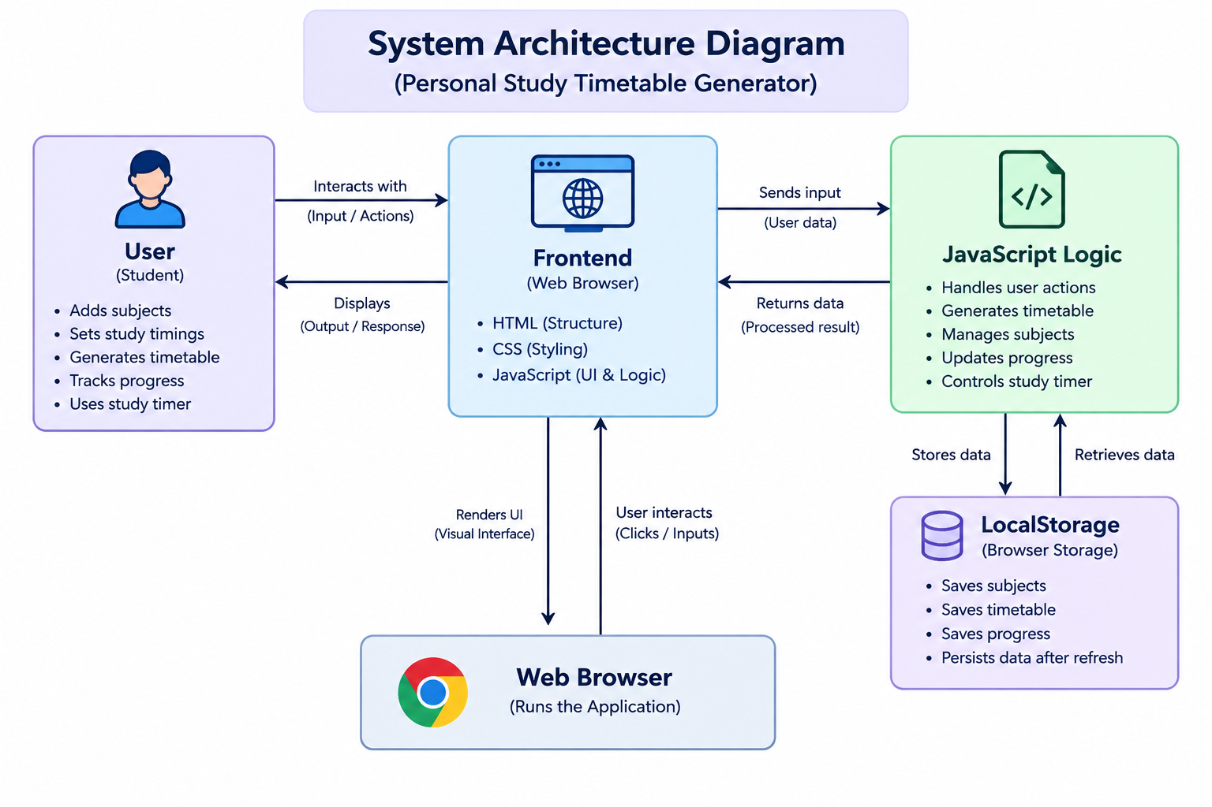
SYSTEM ARCHITECTURE/IDEATION MAP

Slide 8
MODULE IMPLEMENTATION
Subject Management Module – add, edit, delete subjects, set custom study timings, and manage study durations.
Timetable Generation Module – generate personalized daily timetables, arrange study sessions, and prevent time conflicts.
Study Timer Module – start, pause, resume, and reset study sessions with customizable study and break durations.
Progress Tracking Module – monitor completed study sessions, calculate total study hours, and display subject-wise progress.
Dashboard Module – display total subjects, daily study hours, completed sessions, and overall study progress.
Timetable Management Module – view, update, delete, and print daily study schedules.
Data Storage Module – use browser Local Storage to save subjects, timetables, and progress data, ensuring persistence after refreshing.
Validation Module – validate subject details, check study timings, prevent overlapping schedules, and display error messages.

Slide 9
RESULT AND DISCUSSIONS
Subject Management – allows students to add, edit, delete, and manage subjects with custom timings.
Timetable Generation – creates personalized study schedules while avoiding overlapping sessions.
Study Timer – manages study sessions with start, pause, resume, and reset options.
Progress Tracking – displays completed study sessions, total study hours, and subject-wise progress.
Dashboard – provides an overview of subjects, planned study hours, and daily progress.
Data Storage – uses Local Storage to save subjects, timetables, and progress for future access.
User-Friendly Interface – provides easy navigation with dark and light mode options.

Slide 10
CONCLUSION
The Personal Study Timetable Generator provides an efficient and user-friendly solution for managing study schedules. It allows students to add subjects, set custom timings, generate personalized timetables, and track their study progress. By using HTML, CSS, JavaScript, and Local Storage, the application offers a simple and reliable study planning experience. Overall, this project helps improve time management, increase productivity, and develop consistent study habits.

Slide 11
REFERENCES
MDN Web Docs, "HTML: Hyper Text Markup Language," Mozilla Foundation. Link: https://developer.mozilla.org/en-US/docs/Web/HTML
MDN Web Docs, "JavaScript Guide," Mozilla Foundation. Link: https://developer.mozilla.org/en-US/docs/Web/JavaScript/Guide
MDN Web Docs, "Web Storage API," Mozilla Foundation. Link: https://developer.mozilla.org/en-US/docs/Web/API/Web_Storage_API
W3Schools, "CSS Tutorial," W3Schools. Link: https://www.w3schools.com/css/

Slide 12
THANK YOU
We thank God, Our Department, Guide, Panel Members, Supportive Professors and all Technical and non Technical staff who helped us in our Project.

